Slide 1
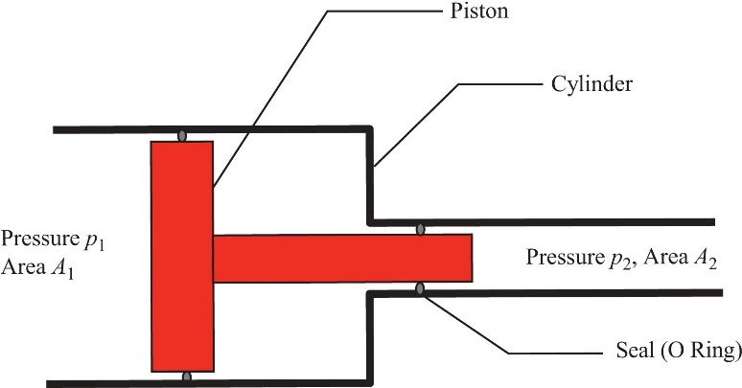
FIGURE 5.1 Schematic Diagram of Pressure Intensifier

Slide 2
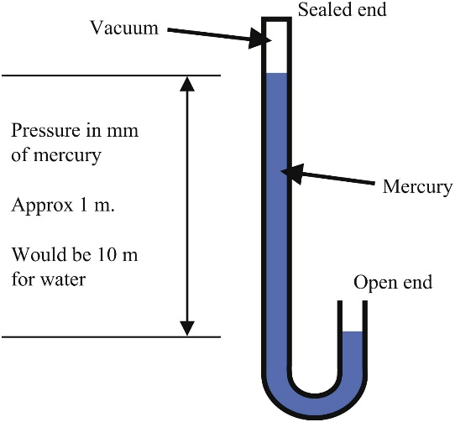
FIGURE 5.2 Mercury Barometer

Slide 3
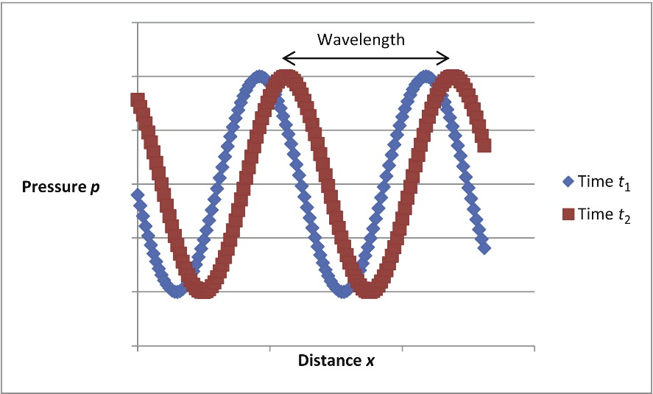
FIGURE 5.3 Movement of a Wave

